Slide 1
Machine Learning Summer School Day 4
Ricardo Henao

Slide 2
Outline: Generative Adversarial Networks (GANs)
Concepts of data synthesis
Sampling from distributions
Discrete distributions
Empirical distributions
Continuous distributions
Learning parametric distributions then sampling
Learning parametric distributions
Sampling from learned parametric distributions
Learning to sample from an unknown distribution
Learning autoencoding generative models
Learning adversarially
Synthesizing images
Natural images: Progressive Growing of GANs (2018)
Art: Creative Adversarial Networks (2017)
Anime character generation: Towards the Automatic Anime Characters Creation (2017)
Adversarial Learning
Basics and notation
Distribution, expectation, generator, discriminator and objective
Learning adversarially revisited
Conditional adversarial learning
Adversarial disentanglement

Slide 3
Generative Adversarial Networks
Part I: Concepts of Data Synthesis

Slide 4
Sampling from discrete distributions
Example 1: coin flip
Observations take 2 values: heads and tails, each one happening with equal probability (equally likely).
Probability(heads) = Probability(tails) = 0.5
Assumption: the coin is fair.

Slide 5
Sampling from discrete distributions
Example 2: die rolling
Observations take 6 values: 1, 2, …, 6, each one happening with equal probability (equally likely).
Probability(1) = Probability(2) = … = Probability(6) = 1/6
Assumption: the die is fair.

Slide 6
Sampling from empirical distributions
Example 3: bag of objects
Observations can be one of 10 objects, each one happening with equal probability (equally likely).
Probability(1) = Probability(2) = … = Probability(10) = 1/10
Assumption: the objects in the bag are unique.
Note: we could sample without replacement
Probability(any 1st draw) = 1/10, Probability(any 2nd draw|1st draw) = 1/9, …, Probability(any 10th draw|9th draw, …) = 1
?

Slide 7
Sampling from a continuous distribution
Example 4: numbers between 0 and 1
From previous example, let the bag have a large number of objects, say 1, 2, …, 2⁴⁸-1.
Draw one number from the bag and divide it by 2⁴⁸, the resulting number is between 0 and 1 (excluding 0 and 1).
Note: each number in the bag has the same probability of being drawn, Probability(number) = 1/(2⁴⁸-1).
Computationally, “drawing from the bag” is implemented by generating the sequence 1, 2, …, 2⁴⁸-1 in random order.

Slide 8
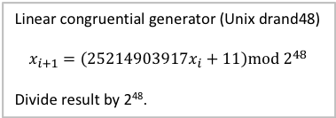
Sampling from a continuous distribution
Example 4: numbers between 0 and 1
From previous example, let the bag have a large number of objects, say 1, 2, …, 2⁴⁸-1.
Draw one number from the bag and divide it by 2⁴⁸, the resulting number is between 0 and 1 (excluding 0 and 1).
Note: each number in the bag has the same probability of being drawn, Probability(number) = 1/(2⁴⁸-1).
Computationally, “drawing from the bag” is implemented by generating the sequence 1, 2, …, 2⁴⁸-1 in random order.
Linear congruential generator (Unix drand48)
$$x_{i+1}=\left(25214903917x_{i}+11\right)mod 2^{48}$$
Divide result by 2⁴⁸.

Slide 9
Sampling from discrete distributions
Example 5: dice rolling
Observations take 11 values: 2, …, 12, each one happening with probability:
Probability(2) = 1/36, Probability(3) = 2/36, Probability(4) = 3/36, Probability(5) = 4/36, Probability(6) = 5/36, Probability(7) = 6/36
Probability(12) = 1/36, Probability(11) = 2/36, Probability(10) = 3/36, Probability(9) = 4/36, Probability(8) = 5/36
Assumption: the dice are fair and independent.
Note: we could roll a single die in sequence, then add the results.
 | 1 | 2 | 3 | 4 | 5 | 6
1 | 2 | 3 | 4 | 5 | 6 | 7
2 | 3 | 4 | 5 | 6 | 7 | 8
3 | 4 | 5 | 6 | 7 | 8 | 9
4 | 5 | 6 | 7 | 8 | 9 | 10
5 | 6 | 7 | 8 | 9 | 10 | 11
6 | 7 | 8 | 9 | 10 | 11 | 12

Slide 10
Sampling from empirical distributions
Examples 1-4 represent uniform distributions, provided the probability of every outcome is the same.
The uniform distribution between 0 and 1 can be denoted as Uniform(0,1).

Slide 11
Sampling from empirical distributions
Examples 1-4 represent uniform distributions, provided the probability of every outcome is the same.
The uniform distribution between 0 and 1 can be denoted as Uniform(0,1).
Questions:
How do we know that the coin/die is fair?
How do we know if two dice produce the same results (i.e., have the same probabilities)?
How do we know if a bag of objects has more that one type of object?
What if we do not know the total number of objects in the bag of objects?
What if we want to see objects like in the bag but that we know for sure are not in the bag of objects?

Slide 12
Sampling from empirical distributions
Examples 1-4 represent uniform distributions, provided the probability of every outcome is the same.
The uniform distribution between 0 and 1 can be denoted as Uniform(0,1).
Questions:
How do we know that the coin/die is fair?
How do we know if two dice produce the same results (i.e., have the same probabilities)?
How do we know if a bag of objects has more that one type of object?
What if we do not know the total number of objects in the bag of objects?
What if we want to see objects like in the bag but that we know for sure are not in the bag of objects?
Answers:
{1,2,3,4} can be answered using standard statistical methods.
Adversarial learning attempts to answer 5 for complex objects (e.g., images).

Slide 13
Learning parametric distributions
Example 1:
flip coin N=100 times.
Calculate Frequency(heads) = #heads/N and Frequency(tails) = #tails/N.
The parameters of the distribution can be estimated (approximated) by frequencies:
Probability(heads) ≈ Frequency(heads) and Probability(tails) ≈ Frequency(heads)
The approximation gets better as N increases.
Note: since Probability(heads) + Probability(tails) = 1, we only need to a estimate one of them so:
Probability(heads) ≈ Frequency(heads) and Probability(tails) = 1 - Frequency(heads)

Slide 14
Learning parametric distributions
Example 2:
Roll die N=100 times.
Calculate Frequency(1) = #1/N, …, Frequency(6) = #6/N.
The parameters of the distribution can be estimated (approximated) by frequencies:
Probability(1) ≈ Frequency(1), …, Probability(6) ≈ Frequency(6)
The approximation gets better as N increases.
Note: since Probability(1) + … + Probability(6) = 1, we only need to a estimate 5 of them so:
Probability(6) = 1 - Frequency(1) - … - Frequency(5)
Note: a discrete distribution taking K values has K-1 parameters.

Slide 15

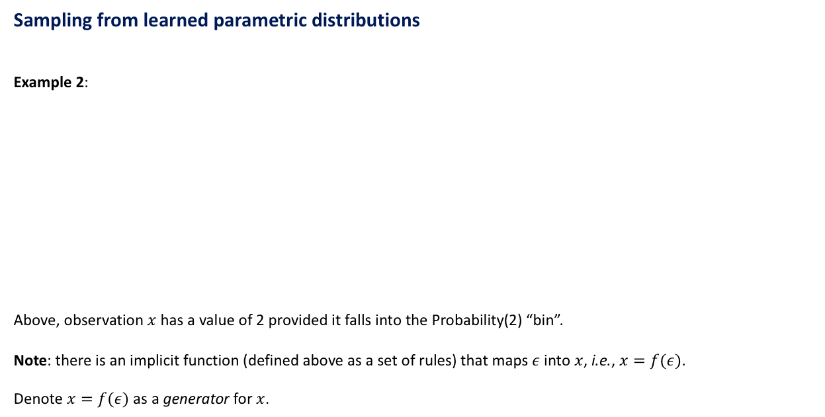
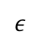
Sampling from learned parametric distributions
Example 2:
Above, observation $x$ has a value of 2 provided it falls into the Probability(2) “bin”.
Note: there is an implicit function (defined above as a set of rules) that maps $ε$ into $x$, i.e., $x=f(ε)$.
Denote $x=f(ε)$ as a generator for $x$.
1 - Frequency(1) - … - Frequency(5)
Probability(1)
Probability(2)
. . .
Probability(6)
0
$$ε$$
1
Draw $ε$ from Uniform(0,1) using Example 4

Slide 16
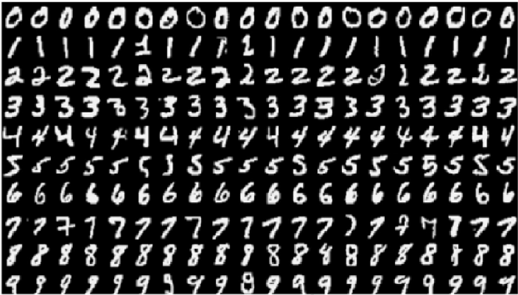
Learning to sample from an unknown distribution
Example 5: handwritten digits (MNIST, N=60,000 images)
Option 1 (no learning): We can use the bag of objects approach in Example 3, but we can only generate N=60,000 distinct images, bad generalization.

Slide 17
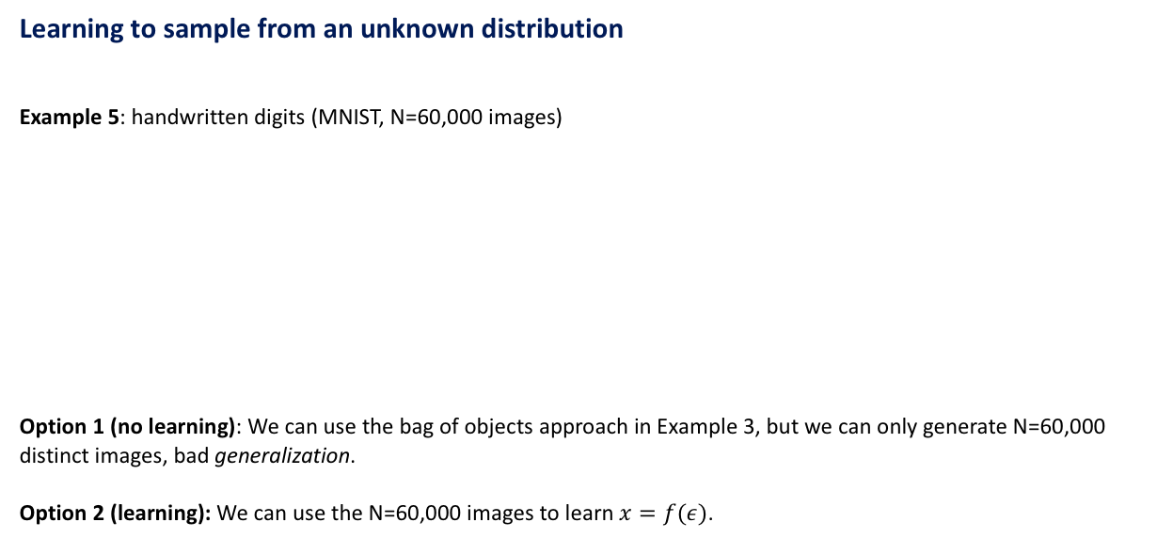
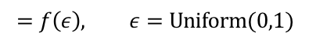
Learning to sample from an unknown distribution
Example 5: handwritten digits (MNIST, N=60,000 images)
Option 1 (no learning): We can use the bag of objects approach in Example 3, but we can only generate N=60,000 distinct images, bad generalization.
Option 2 (learning): We can use the N=60,000 images to learn $x=f(ε)$.
$$=f\left(ε\right), ε=Uniform(0,1)$$

Slide 18
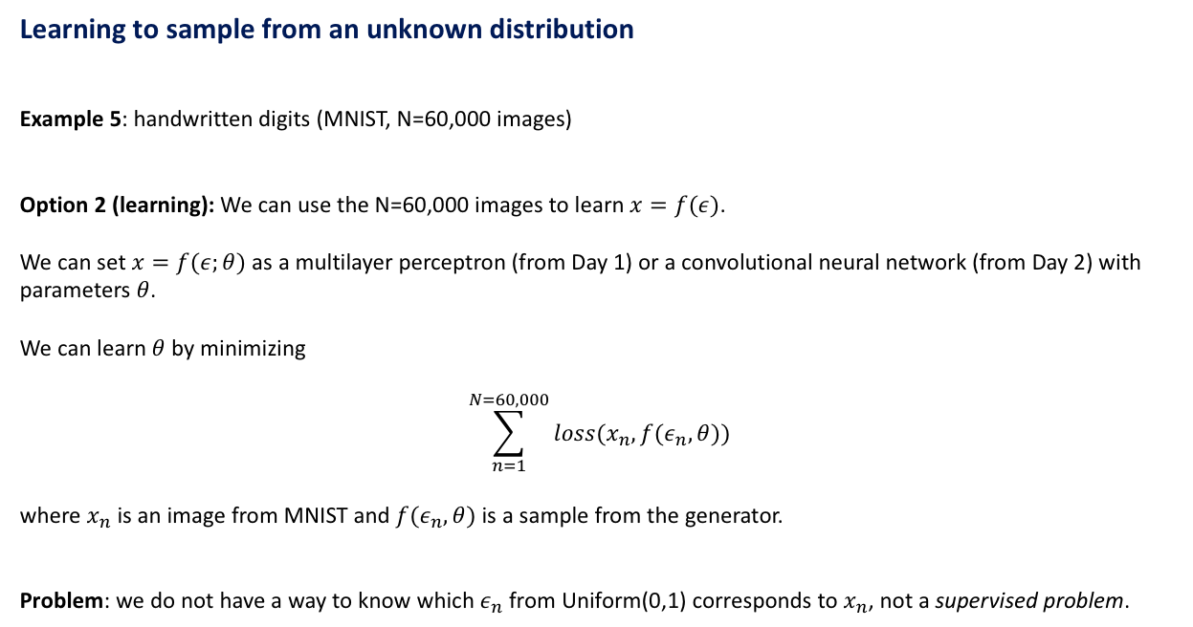
Learning to sample from an unknown distribution
Example 5: handwritten digits (MNIST, N=60,000 images)
Option 2 (learning): We can use the N=60,000 images to learn $x=f(ε)$.
We can set $x=f(ε;θ)$ as a multilayer perceptron (from Day 1) or a convolutional neural network (from Day 2) with parameters $θ$.
We can learn $θ$ by minimizing
$$\sum_{n=1}^{N=60,000}{loss(x_{n},f(ε_{n},θ))}$$
where $x_{n}$ is an image from MNIST and $f(ε_{n},θ)$ is a sample from the generator.
Problem: we do not have a way to know which $ε_{n}$ from Uniform(0,1) corresponds to $x_{n}$, not a supervised problem.

Slide 19
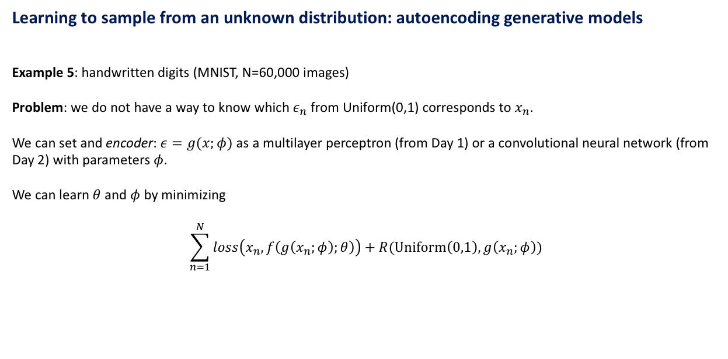
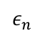
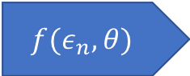
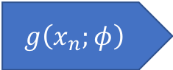
Learning to sample from an unknown distribution: autoencoding generative models
Example 5: handwritten digits (MNIST, N=60,000 images)
Problem: we do not have a way to know which $ε_{n}$ from Uniform(0,1) corresponds to $x_{n}$.
We can set and encoder: $ε=g(x;φ)$ as a multilayer perceptron (from Day 1) or a convolutional neural network (from Day 2) with parameters $φ$.
We can learn $θ$ and $φ$ by minimizing
$$\sum_{n=1}^{N}{loss\left(x_{n},f\left(g\left(x_{n};φ\right);θ\right)\right)+R(Uniform\left(0,1\right),g\left(x_{n};φ\right))}$$
$$g\left(x_{n};φ\right)$$
$ε_{n}$
$$f(ε_{n},θ)$$
Input
Encoder
Generator
Reconstruction
Autoencoder

Slide 20
Learning to sample from an unknown distribution: autoencoding generative models
Example 5: handwritten digits (MNIST, N=60,000 images)
Problem: we do not have a way to know which $ε_{n}$ from Uniform(0,1) corresponds to $x_{n}$.
We can set and encoder: $ε=g(x;φ)$ as a multilayer perceptron (from Day 1) or a convolutional neural network (from Day 2) with parameters $φ$.
We can learn $θ$ and $φ$ by minimizing
$$\sum_{n=1}^{N}{loss\left(x_{n},f\left(g\left(x_{n};φ\right);θ\right)\right)+R(Uniform\left(0,1\right),g\left(x_{n};φ\right))}$$
Data fit
Distribution fit
$$g\left(x_{n};φ\right)$$
$ε_{n}$
$$f(ε_{n},θ)$$
Input
Encoder
Generator
Reconstruction
Autoencoder

Slide 21
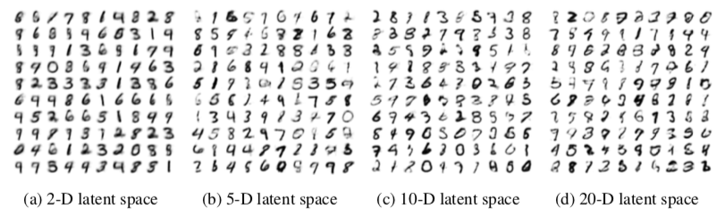
Learning to sample from an unknown distribution: autoencoding generative models
Example 5: handwritten digits (MNIST, N=60,000 images)
Samples generated by an autoencoder:
Kingma and Welling, ICLR 2014

Slide 22
Learning to sample from an unknown distribution: autoencoding generative models
Example 5: handwritten digits (MNIST, N=60,000 images)
Samples generated by an autoencoder:
Problem: some samples do not look like digits.
Kingma and Welling, ICLR 2014

Slide 23
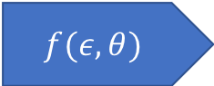
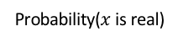
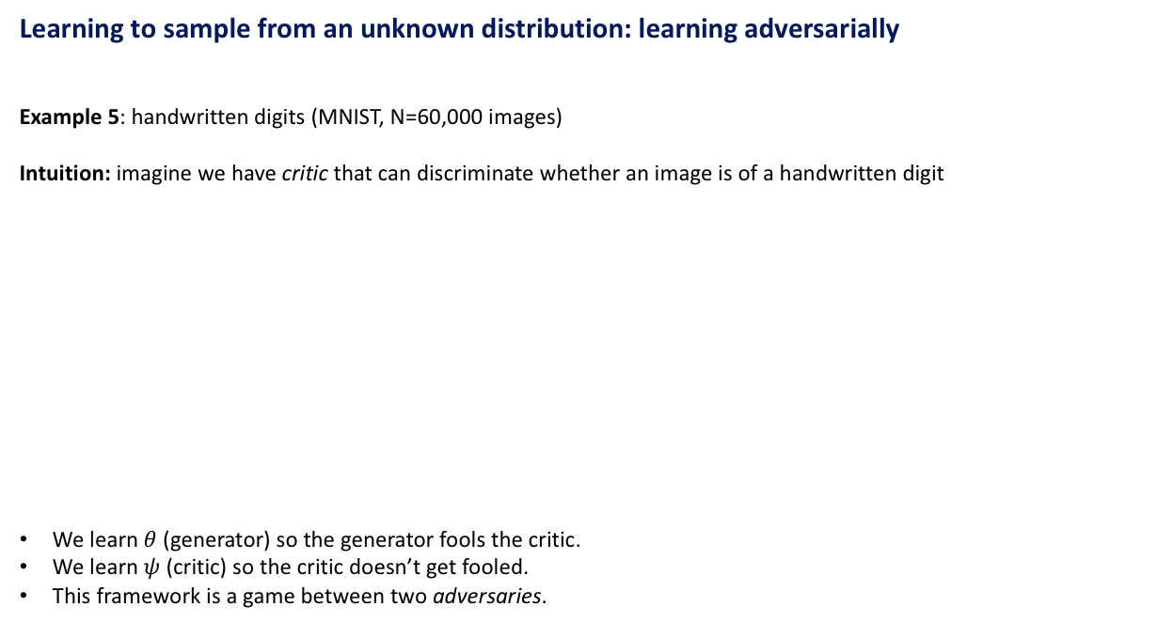
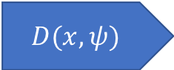
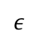
Learning to sample from an unknown distribution: learning adversarially
Example 5: handwritten digits (MNIST, N=60,000 images)
Intuition: imagine we have critic that can discriminate whether an image is of a handwritten digit
We learn $θ$ (generator) so the generator fools the critic.
We learn $ψ$ (critic) so the critic doesn’t get fooled.
This framework is a game between two adversaries.
Generated image
$ε$
$$f(ε,θ)$$
$$D(x,ψ)$$
Probability($x$ is real)
Generator
Critic
Real image

Slide 24
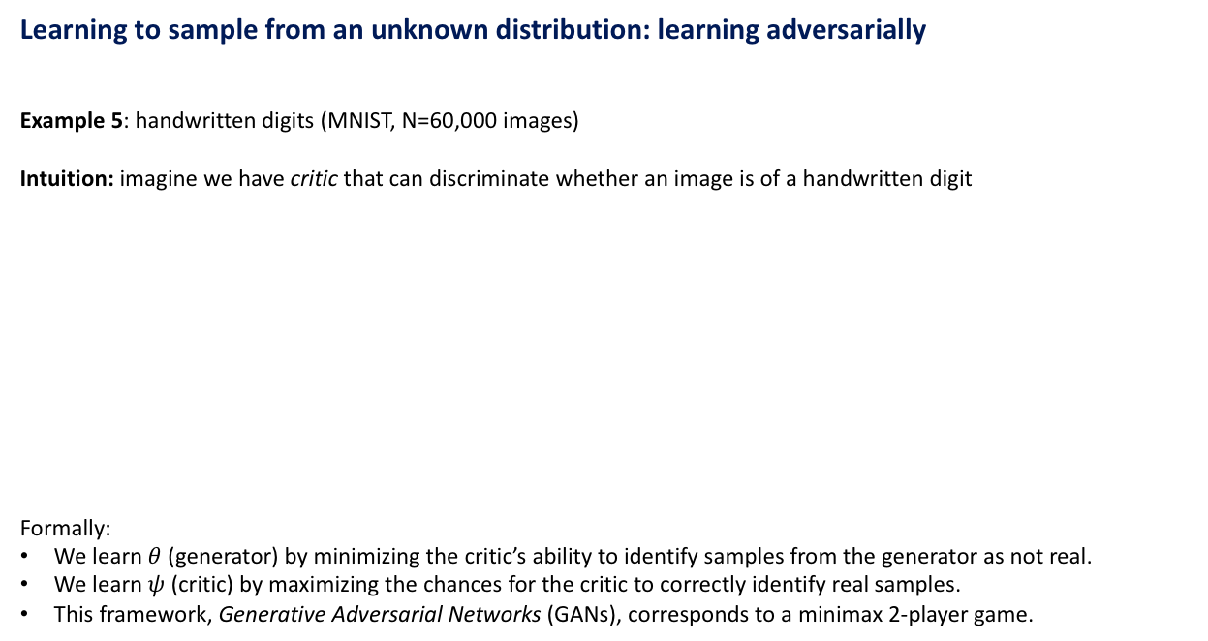
Learning to sample from an unknown distribution: learning adversarially
Example 5: handwritten digits (MNIST, N=60,000 images)
Intuition: imagine we have critic that can discriminate whether an image is of a handwritten digit
Formally:
We learn $θ$ (generator) by minimizing the critic’s ability to identify samples from the generator as not real.
We learn $ψ$ (critic) by maximizing the chances for the critic to correctly identify real samples.
This framework, Generative Adversarial Networks (GANs), corresponds to a minimax 2-player game.
Generated image
$ε$
$$f(ε,θ)$$
$$D(x,ψ)$$
Probability($x$ is real)
Generator
Critic
Real image

Slide 25
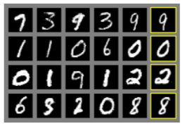
Learning to sample from an unknown distribution: learning adversarially
Example 5: handwritten digits (MNIST, N=60,000 images)
Samples generated by a generator learned adversarially:
Closest image from MNIST set
Generated samples
Goodfellow et al, NIPS 2014

Slide 26
Learning to sample from an unknown distribution: learning adversarially
Example 5: handwritten digits (MNIST, N=60,000 images)
Samples generated by a generator learned adversarially:
Closest image from MNIST set
The model generalizes
Generated samples
Goodfellow et al, NIPS 2014

Slide 27
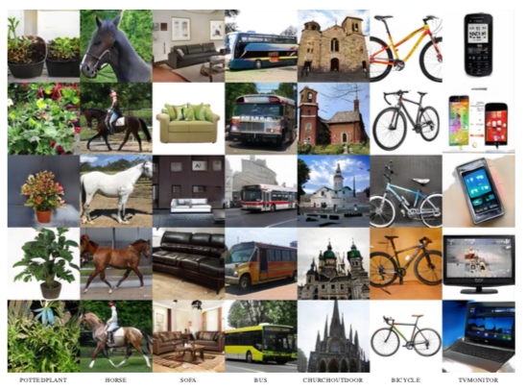
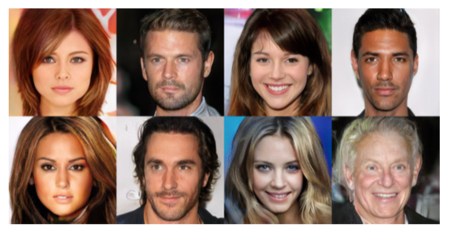
Synthesizing images: Natural images
Progressive growing of GANs
1024x1024 images using CelebA-HQ dataset
256x256 images using LSUN dataset
Karras et al, NIPS 2018

Slide 28
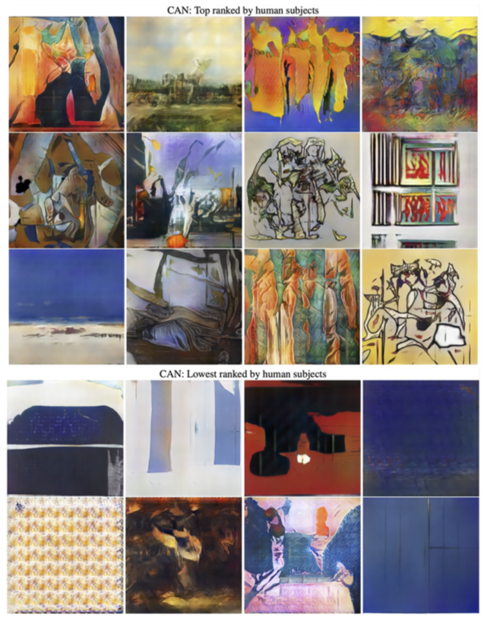
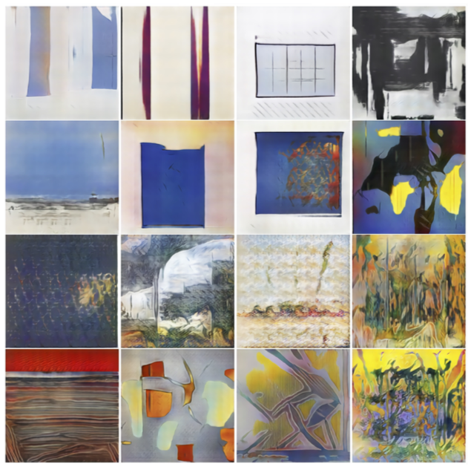
Synthesizing images: Natural images
Creative adversarial networks
256x256 image samples using WikiArt dataset
Elgammal et al, ICCC 2017

Slide 29
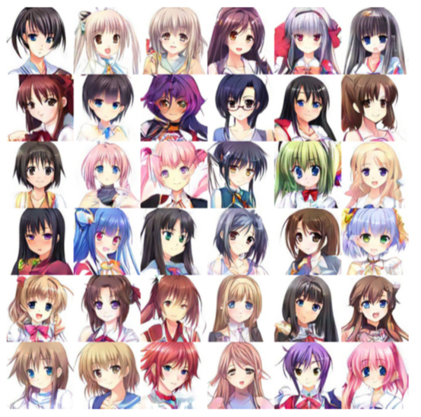
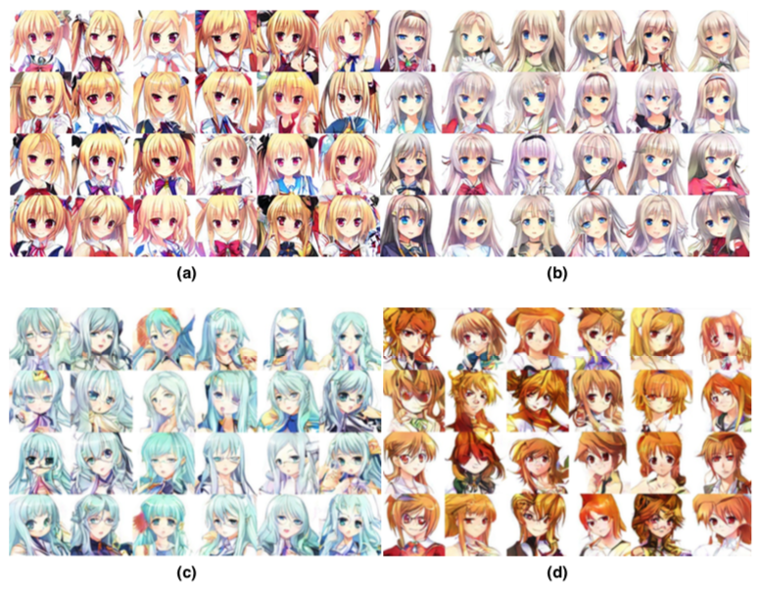
Synthesizing images: Natural images
Automatic Anime Characters Creation with Generative Adversarial Networks
128x128 image samples
Jin et al, Comiket 2017

Slide 30
Generative Adversarial Networks
Part II: Adversarial Learning

Slide 31

Basics and notation
We denote the distribution of $x$ (usually unknown) as $p\left(x\right)$ and $x\sim p\left(x\right)$ as a sample $x$ of $p\left(x\right)$.

Slide 32
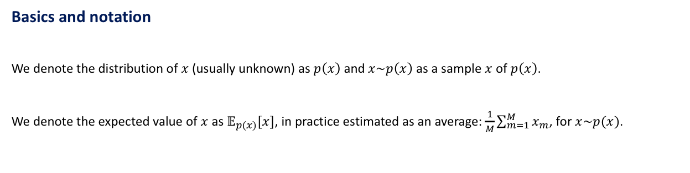
Basics and notation
We denote the distribution of $x$ (usually unknown) as $p\left(x\right)$ and $x\sim p\left(x\right)$ as a sample $x$ of $p\left(x\right)$.
We denote the expected value of $x$ as $𝔼_{p(x)}[x]$, in practice estimated as an average: $\frac{1}{M}\sum_{m=1}^{M}{x_{m}}$, for $x\sim p(x)$.

Slide 33
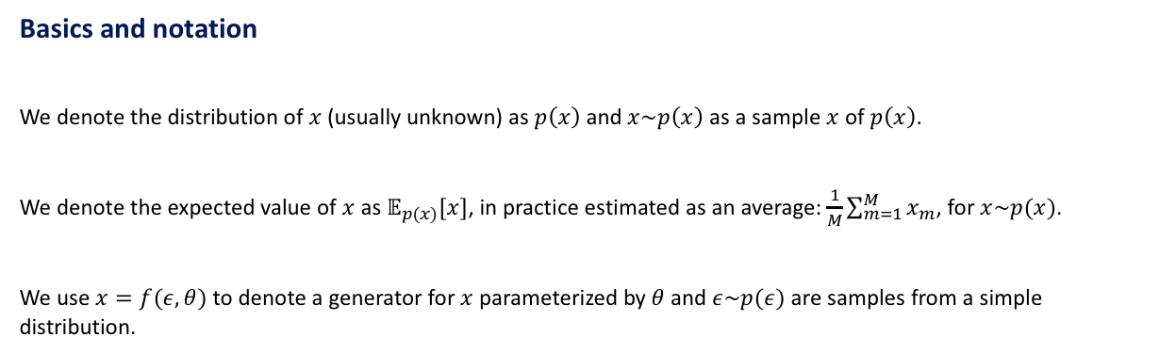
Basics and notation
We denote the distribution of $x$ (usually unknown) as $p\left(x\right)$ and $x\sim p\left(x\right)$ as a sample $x$ of $p\left(x\right)$.
We denote the expected value of $x$ as $𝔼_{p(x)}[x]$, in practice estimated as an average: $\frac{1}{M}\sum_{m=1}^{M}{x_{m}}$, for $x\sim p(x)$.
We use $x=f(ε,θ)$ to denote a generator for $x$ parameterized by $θ$ and $ε\sim p(ε)$ are samples from a simple distribution.

Slide 34
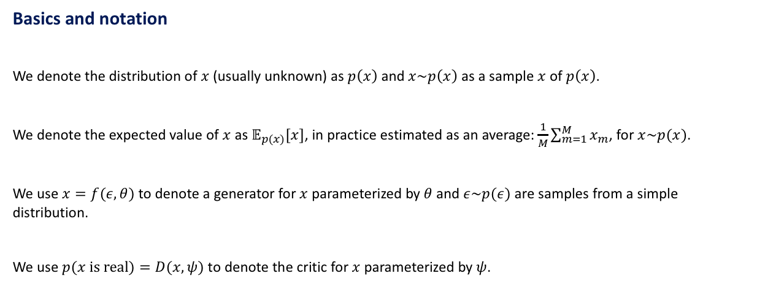
Basics and notation
We denote the distribution of $x$ (usually unknown) as $p\left(x\right)$ and $x\sim p\left(x\right)$ as a sample $x$ of $p\left(x\right)$.
We denote the expected value of $x$ as $𝔼_{p(x)}[x]$, in practice estimated as an average: $\frac{1}{M}\sum_{m=1}^{M}{x_{m}}$, for $x\sim p(x)$.
We use $x=f(ε,θ)$ to denote a generator for $x$ parameterized by $θ$ and $ε\sim p(ε)$ are samples from a simple distribution.
We use $p(x is real)=D(x,ψ)$ to denote the critic for $x$ parameterized by $ψ$.

Slide 35
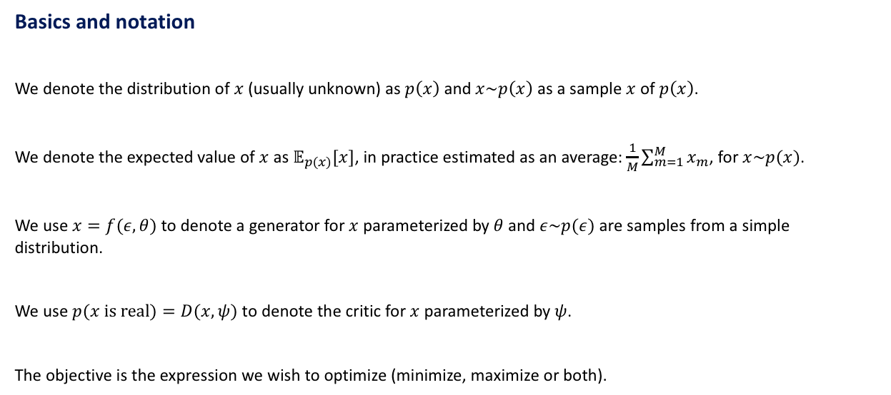
Basics and notation
We denote the distribution of $x$ (usually unknown) as $p\left(x\right)$ and $x\sim p\left(x\right)$ as a sample $x$ of $p\left(x\right)$.
We denote the expected value of $x$ as $𝔼_{p(x)}[x]$, in practice estimated as an average: $\frac{1}{M}\sum_{m=1}^{M}{x_{m}}$, for $x\sim p(x)$.
We use $x=f(ε,θ)$ to denote a generator for $x$ parameterized by $θ$ and $ε\sim p(ε)$ are samples from a simple distribution.
We use $p(x is real)=D(x,ψ)$ to denote the critic for $x$ parameterized by $ψ$.
The objective is the expression we wish to optimize (minimize, maximize or both).

Slide 36
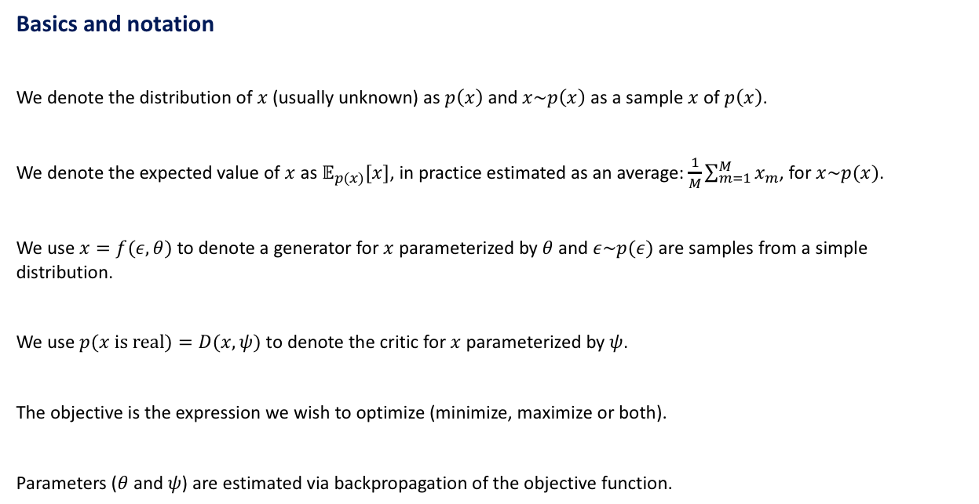
Basics and notation
We denote the distribution of $x$ (usually unknown) as $p\left(x\right)$ and $x\sim p\left(x\right)$ as a sample $x$ of $p\left(x\right)$.
We denote the expected value of $x$ as $𝔼_{p(x)}[x]$, in practice estimated as an average: $\frac{1}{M}\sum_{m=1}^{M}{x_{m}}$, for $x\sim p(x)$.
We use $x=f(ε,θ)$ to denote a generator for $x$ parameterized by $θ$ and $ε\sim p(ε)$ are samples from a simple distribution.
We use $p(x is real)=D(x,ψ)$ to denote the critic for $x$ parameterized by $ψ$.
The objective is the expression we wish to optimize (minimize, maximize or both).
Parameters ($θ$ and $ψ$) are estimated via backpropagation of the objective function.

Slide 37

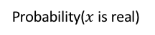
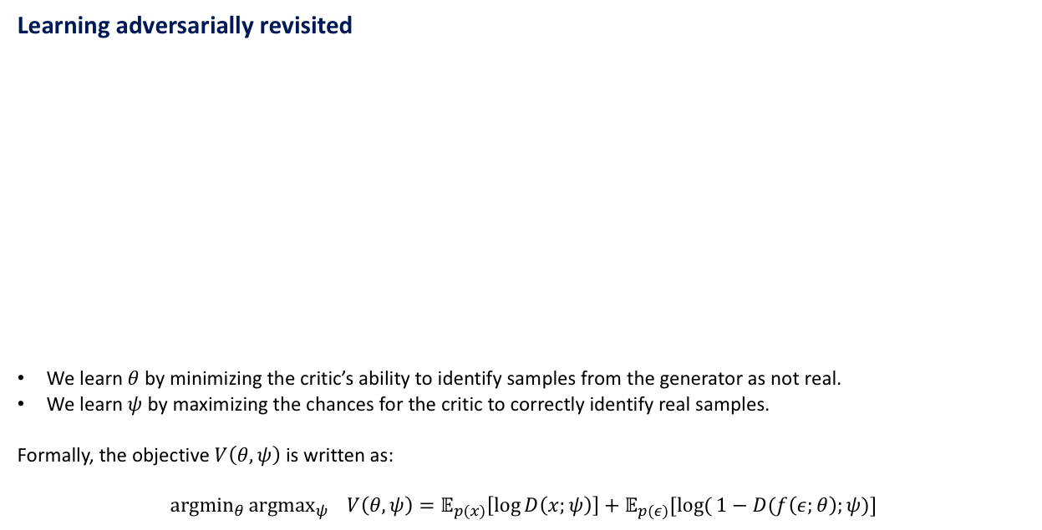
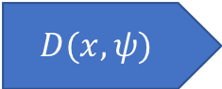
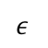
Learning adversarially revisited
We learn $θ$ by minimizing the critic’s ability to identify samples from the generator as not real.
We learn $ψ$ by maximizing the chances for the critic to correctly identify real samples.
Formally, the objective $V\left(θ,ψ\right)$ is written as:
$${argmin}_{θ}{argmax_{ψ} V\left(θ,ψ\right)=𝔼_{p(x)}\left[\log{D\left(x;ψ\right)}\right]+𝔼_{p(ε)}[log({1−D(f\left(ε;θ\right);ψ)}]}$$
Generated image
$ε$
$$f(ε,θ)$$
$$D(x,ψ)$$
Probability($x$ is real)
Generator
Critic
Real image

Slide 38
Learning adversarially revisited
We learn $θ$ by minimizing the critic’s ability to identify samples from the generator as not real.
We learn $ψ$ by maximizing the chances for the critic to correctly identify real samples.
Formally, the objective $V\left(θ,ψ\right)$ is written as:
$${argmin}_{θ}{argmax_{ψ} V\left(θ,ψ\right)=𝔼_{p(x)}\left[\log{D\left(x;ψ\right)}\right]+𝔼_{p(ε)}[log({1−D(f\left(ε;θ\right);ψ)}]}$$
Generated image
$ε$
$$f(ε,θ)$$
$$D(x,ψ)$$
Probability($x$ is real)
Generator
Critic
Real image
Sample from empirical distribution (bag of objects)
Sample from Uniform(0,1)

Slide 39
Learning adversarially revisited
We learn $θ$ by minimizing the critic’s ability to identify samples from the generator as not real.
We learn $ψ$ by maximizing the chances for the critic to correctly identify real samples.
Formally, the objective $V\left(θ,ψ\right)$ is written as:
$${argmin}_{θ}{argmax_{ψ} V\left(θ,ψ\right)=𝔼_{p(x)}\left[\log{D\left(x;ψ\right)}\right]+𝔼_{p(ε)}[log({1−D(f\left(ε;θ\right);ψ)}]}$$
Generated image
$ε$
$$f(ε,θ)$$
$$D(x,ψ)$$
Probability($x$ is real)
Generator
Critic
Real image
The critic is right
The critic cannot be fooled

Slide 40
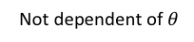
Learning adversarially revisited
We learn $θ$ by minimizing the critic’s ability to identify samples from the generator as not real.
We learn $ψ$ by maximizing the chances for the critic to correctly identify real samples.
Formally, the objective $V\left(θ,ψ\right)$ is written as:
$${argmin}_{θ}{argmax_{ψ} V\left(θ,ψ\right)=𝔼_{p(x)}\left[\log{D\left(x;ψ\right)}\right]+𝔼_{p(ε)}[log({1−D(f\left(ε;θ\right);ψ)}]}$$
Generated image
$ε$
$$f(ε,θ)$$
$$D(x,ψ)$$
Probability($x$ is real)
Generator
Critic
Real image
Not dependent of $θ$
The critic is fooled

Slide 41

Learning adversarially revisited
For images:
Specify $f(ε,θ)$ as a deep convolutional neural network (Day 2).
Specify $D(x,ψ)$ as a deep convolutional network classifier (Day 2).
Generated image
$ε$
$$f(ε,θ)$$
$$D(x,ψ)$$
Probability($x$ is real)
Generator
Critic
Real image

Slide 42
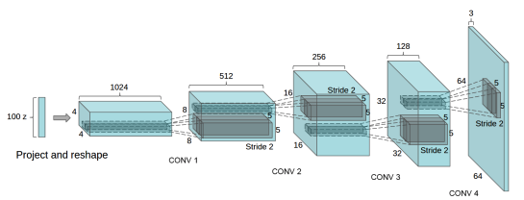
Learning adversarially revisited
Generated image
$ε$
$$f(ε,θ)$$
$$D(x,ψ)$$
Probability($x$ is real)
Generator
Critic
CNN classifier from Day 2
Real image
Radford et al, ICLR 2016

Slide 43
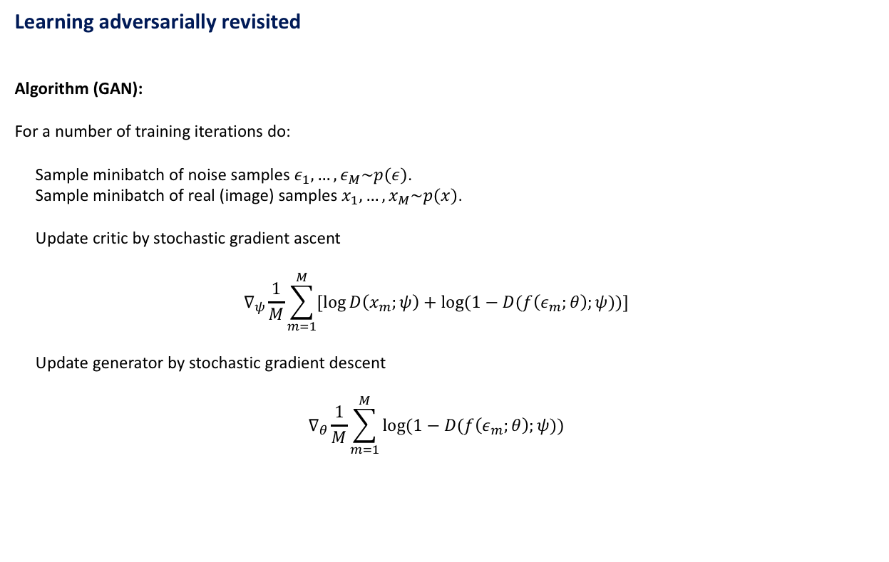
Learning adversarially revisited
Algorithm (GAN):
For a number of training iterations do:
Sample minibatch of noise samples $ε_{1},…,ε_{M}\sim p(ε)$.
Sample minibatch of real (image) samples $x_{1},…,x_{M}\sim p(x)$.
Update critic by stochastic gradient ascent
$$∇_{ψ}\frac{1}{M}\sum_{m=1}^{M}{[\log{D\left(x_{m};ψ\right)+\log{(1−D(f\left(ε_{m};θ\right);ψ))}}]}$$
Update generator by stochastic gradient descent
$$∇_{θ}\frac{1}{M}\sum_{m=1}^{M}{\log{(1−D(f\left(ε_{m};θ\right);ψ))}}$$

Slide 44
Learning adversarially revisited
Algorithm (GAN):
For a number of training iterations do:
Sample minibatch of noise samples $ε_{1},…,ε_{M}\sim p(ε)$.
Sample minibatch of real (image) samples $x_{1},…,x_{M}\sim p(x)$.
Update critic by stochastic gradient ascent
$$∇_{ψ}\frac{1}{M}\sum_{m=1}^{M}{[\log{D\left(x_{m};ψ\right)+\log{(1−D(f\left(ε_{m};θ\right);ψ))}}]}$$
Update generator by stochastic gradient descent
$$∇_{θ}\frac{1}{M}\sum_{m=1}^{M}{\log{(1−D(f\left(ε_{m};θ\right);ψ))}}$$
Sample from Uniform(0,1)
Sample from empirical distribution (bag of objects)

Slide 45
Learning adversarially revisited
Algorithm (GAN):
For a number of training iterations do:
Sample minibatch of noise samples $ε_{1},…,ε_{M}\sim p(ε)$.
Sample minibatch of real (image) samples $x_{1},…,x_{M}\sim p(x)$.
Update critic by stochastic gradient ascent
$$∇_{ψ}\frac{1}{M}\sum_{m=1}^{M}{[\log{D\left(x_{m};ψ\right)+\log{(1−D(f\left(ε_{m};θ\right);ψ))}}]}$$
Update generator by stochastic gradient descent
$$∇_{θ}\frac{1}{M}\sum_{m=1}^{M}{\log{(1−D(f\left(ε_{m};θ\right);ψ))}}$$
Sample from Uniform(0,1)
Sample from empirical distribution (bag of objects)
Expectation replaced by averages

Slide 46
Learning adversarially revisited
Algorithm (GAN):
For a number of training iterations do:
Sample minibatch of noise samples $ε_{1},…,ε_{M}\sim p(ε)$.
Sample minibatch of real (image) samples $x_{1},…,x_{M}\sim p(x)$.
Update critic by stochastic gradient ascent
$$∇_{ψ}\frac{1}{M}\sum_{m=1}^{M}{[\log{D\left(x_{m};ψ\right)+\log{(1−D(f\left(ε_{m};θ\right);ψ))}}]}$$
Update generator by stochastic gradient descent
$$∇_{θ}\frac{1}{M}\sum_{m=1}^{M}{\log{(1−D(f\left(ε_{m};θ\right);ψ))}}$$
Sample from Uniform(0,1)
Sample from empirical distribution (bag of objects)
Expectation replaced by averages
Fixed generator parameters $θ$ in critic update
Fixed critic parameters $ψ$ in generator update

Slide 47
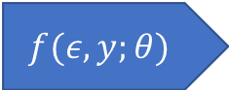

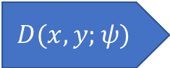
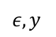
Conditional adversarial learning
We learn $θ$ by minimizing the critic’s ability to identify samples from the generator as not real.
We learn $ψ$ by maximizing the chances for the critic to correctly identify real samples.
Formally, the objective $V\left(θ,ψ\right)$ is written as:
$${argmin}_{θ}{argmax_{ψ} V\left(θ,ψ\right)=𝔼_{p(x)}\left[\log{D\left(x,y;ψ\right)}\right]+𝔼_{p(ε)}[log({1−D(f\left(ε,y;θ\right),y;ψ)}]}$$
Generated image
$ε,y$
$$f(ε,y;θ)$$
$$D(x,y;ψ)$$
Probability($x$ is real)
Generator
Critic
Real image

Slide 48
Conditional adversarial learning
We learn $θ$ by minimizing the critic’s ability to identify samples from the generator as not real.
We learn $ψ$ by maximizing the chances for the critic to correctly identify real samples.
Formally, the objective $V\left(θ,ψ\right)$ is written as:
$${argmin}_{θ}{argmax_{ψ} V\left(θ,ψ\right)=𝔼_{p(x)}\left[\log{D\left(x,y;ψ\right)}\right]+𝔼_{p(ε)}[log({1−D(f\left(ε,y;θ\right),y;ψ)}]}$$
Generated image
$ε,y$
$$f(ε,y;θ)$$
$$D(x,y;ψ)$$
Probability($x$ is real)
Generator
Labels
Critic
Real image
Labels

Slide 49
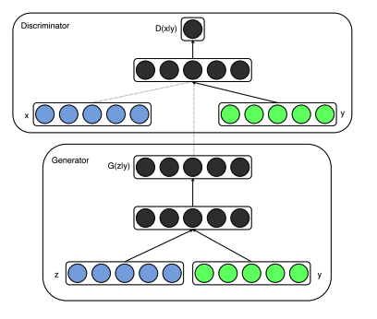
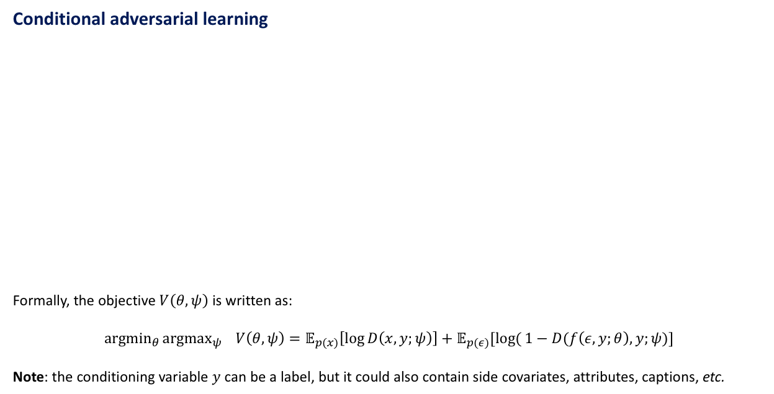
Conditional adversarial learning
Formally, the objective $V\left(θ,ψ\right)$ is written as:
$${argmin}_{θ}{argmax_{ψ} V\left(θ,ψ\right)=𝔼_{p(x)}\left[\log{D\left(x,y;ψ\right)}\right]+𝔼_{p(ε)}[log({1−D(f\left(ε,y;θ\right),y;ψ)}]}$$
Note: the conditioning variable $y$ can be a label, but it could also contain side covariates, attributes, captions, etc.
Critic
Generator

Slide 50

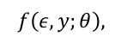
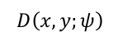
Conditional adversarial learning
$$D(f\left(ε,y;θ\right),$$
Formally, the objective $V\left(θ,ψ\right)$ is written as:
$${argmin}_{θ}{argmax_{ψ} V\left(θ,ψ\right)=𝔼_{p(x)}\left[\log{D\left(x,y;ψ\right)}\right]+𝔼_{p(ε)}[log({1−D(f\left(ε,y;θ\right),y;ψ)}]}$$
Note: the conditioning variable $y$ can be a label, but it could also contain side covariates, attributes, captions, etc.
Critic
$$D\left(x,y;ψ\right)$$
Sample from empirical distribution (bag of objects)
Labels
Generator
$$f\left(ε,y;θ\right),$$
Sample from Uniform(0,1)

Slide 51
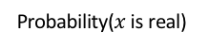
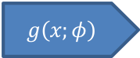
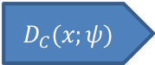
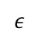
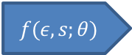
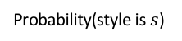


Adversarial disentanglement
$$s$$
Generated image
$$g\left(x;φ\right)$$
$ε$
$$f(ε,s;θ)$$
$$D_{C}(x;ψ)$$
Probability($x$ is real)
Encoder
Generator
Image critic
Real image
$$f(x,s,θ)$$
Probability(style is $s$)
Style critic

Slide 52

Adversarial disentanglement
Style indicator is specified independent of the encoder
$$s$$
Generated image
$$g\left(x;φ\right)$$
$ε$
$$f(ε,s;θ)$$
$$D_{C}(x;ψ)$$
Probability($x$ is real)
Encoder
Generator
Image critic
$ε$ is Uniform(0,1)
Real image
$$f(x,s,θ)$$
Probability(style is $s$)
Style critic
Need data of different styles
$ε$ should not contain information about style

Slide 53
Background Papers
Goodfellow I, Pouget-Abadie J, Mirza M, Xu B, Warde-Farley D, Ozair S, Courville A, Bengio Y. Generative adversarial nets. In Advances in Neural Information Processing Systems (NIPS) 2014. http://papers.nips.cc/paper/5423-generative-adversarial-nets
Radford A, Metz L, Chintala S. Unsupervised representation learning with deep convolutional generative adversarial networks. In International Conference on Learning Representations (ICLR) 2016. https://arxiv.org/abs/1511.06434
Application Papers
Karras T, Aila T, Laine S, Lehtinen J. Progressive growing of GANs for improved quality, stability, and variation. In International Conference on Learning Representations (ICLR) 2018. https://arxiv.org/abs/1710.10196. Source: https://github.com/tkarras/progressive_growing_of_gans
Elgammal A, Liu B, Elhoseiny M, Mazzone M. CAN: Creative Adversarial Networks, Generating "Art" by Learning About Styles and Deviating from Style Norms. In International Conference on Computational Creativity (ICCC) 2017. https://arxiv.org/abs/1706.07068. Source: https://github.com/mlberkeley/Creative-Adversarial-Networks
Jin Y, Zhang J, Li M, Tian Y, Zhu H, Fang Z. Towards the Automatic Anime Characters Creation with Generative Adversarial Networks. In Comiket 92 2017. https://arxiv.org/abs/1708.05509. Source: https://github.com/ctwxdd/Tensorflow-ACGAN-Anime-Generation. Demo: https://make.girls.moe/#/

